Slide 1
Energy and Waves
Transfer of heat

Slide 2
Think about it!
In your own words, define ENERGY.
Have a conversation with your elbow partner.

Slide 3
Let’s share your thoughts
In my opinion, energy is ______.
An example of something that has energy is _____.

Slide 4
Definition of energy and work
According to scientists, energy is the ABILITY to do WORK and cause CHANGE in MATTER.
What is matter?
The substance or substances of which any physical object consists of
What is work?
Movement of matter requiring force (energy)

Slide 5
Potential and Kinetic
Energy can come in one of two forms

Slide 6
Potential Energy
Potential = capable of being or becoming
Potential energy must be energy that is stored.

Slide 7
Kinetic Energy
Kinetic = Involving motion
Kinetic Energy must be energy in motion.

Slide 8
Example #1
What type of energy do you see when you look at a parked car?

Slide 9
What about a car in motion?

Slide 10
Example #2
What type of energy is displayed in these roaring rapids?

Slide 11
…..and here?

Slide 12
Example #3
What about when someone pulls back a bow string?

Slide 13
What would this image look like?
What about when that bow string is released?

Slide 14
Example #4
In this image???

Slide 15
And finally, this one?

Slide 16
Remember…
Potential Energy is simply energy that is stored.
Kinetic Energy is energy in motion

Slide 17
What do I do now teacher?
Read pages 210-213 in your science book with your teacher.
Use your iPad to take some notes on “Waves”. Energy is transferred through waves.

Slide 18
All transverse waves, as opposed to longitudinal, exist on the ELECTROMAGNETIC SPECTRUM.

Slide 19
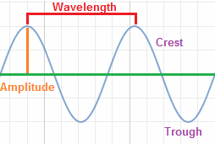
so your notes from last time should pretty much look like this….let’s move on!
You should understand by now that not all wavelengths are created equal. They can have different amplitudes and frequencies.

Slide 20
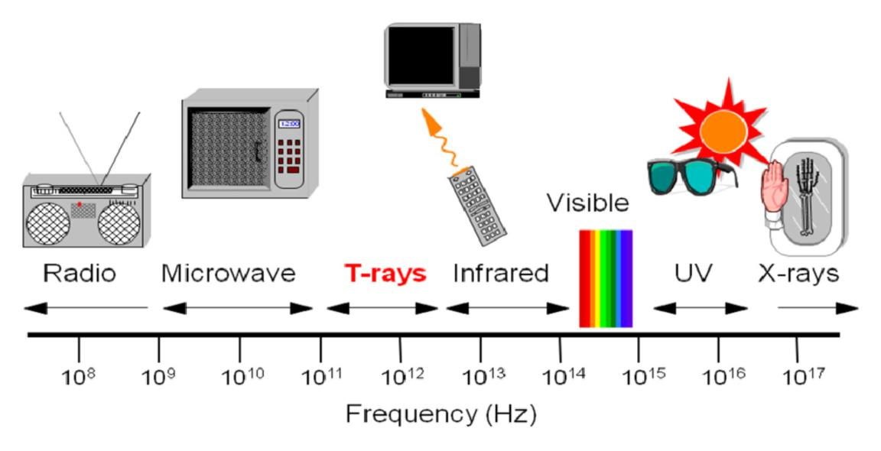
Different types of wavelengths

Slide 21
Types of wavelengths
Radio Waves - very low frequency, long wavelength
Micro Waves – semi-low frequency, semi-long wavelength (begin to generate significant heat)
Infrared Waves – low frequency, shorter wavelength (only visible with infrared goggles)
Visible – amplitude and frequency will determine color (visible to the human eye)
Ultraviolet Waves – high frequency, short wavelength (produced by the sun, can be replicated by humans)
X-Rays – super high frequency, very short wavelength (used to get X-rays at the doctor)
Gamma Rays – Ridiculously-high frequency, extremely short wavelength (CAUTION: Extremely dangerous)

Slide 22
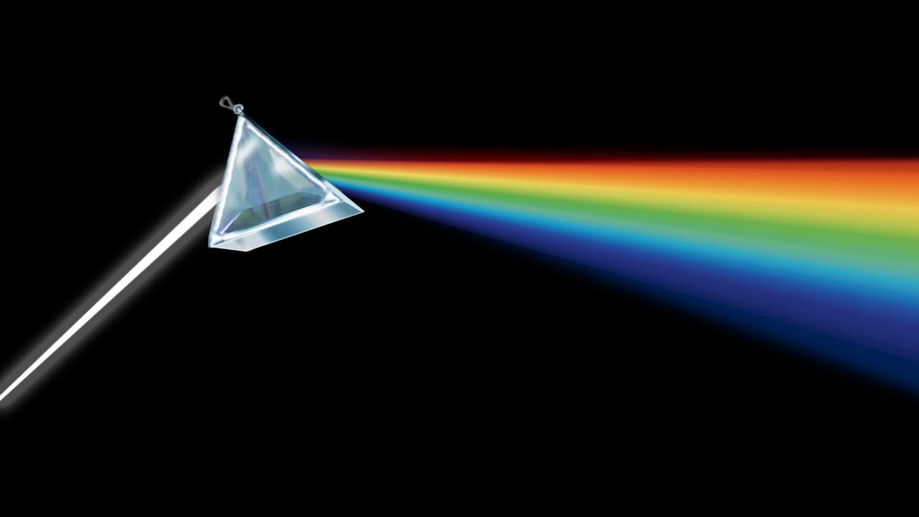
So what???
Remember, waves transfer energy, especially in the form of heat.
Read Pg. 216-217 with your teacher and discuss where these types of waves exist in the real world.

